Slide 1
Unit 1: Psychology’s History and Approaches
UNIT 1: Scientific Foundations of Psychology
PART I: Psychology’s History and
Approaches

Slide 2


Module 5
The Scientific Method and Description
Learning Targets
  3-1 Explain the difference between basic and applied psychology.
  3-2 Describe what psychologists working in various subfields do and where they work.

Slide 3
What is the difference between basic and applied psychology?
What is the difference between
basic and applied psychology?
What is basic research?
What is applied research?
Scientific inquiry that aims to increase psychology’s knowledge base
Pure science
Scientific inquiry that aims to use psychology to solve practical problems
Real-world application of science

Slide 4
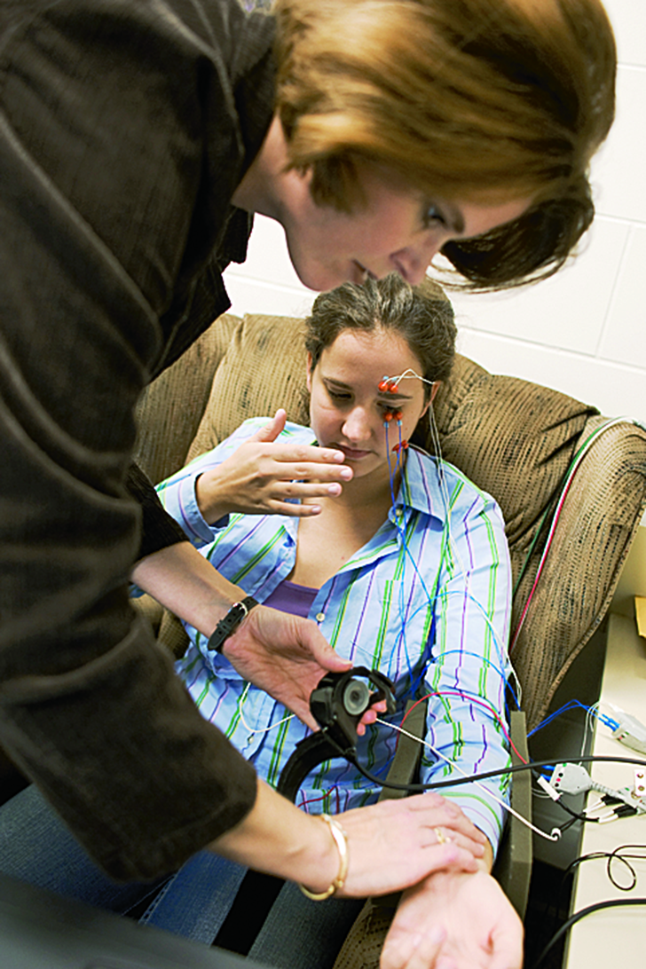
Which types of psychologists conduct basic research?
Which types of psychologists
conduct basic research?
Psychologists Conducting Basic Research
biological psychologists (neuroscientists)
developmental psychologists
cognitive psychologists
educational psychologists
personality psychologists
social psychologists

Slide 5
Which type of psychologists conduct applied research?
Which type of psychologists
conduct applied research?
Psychologists Conducting Applied Research
biological psychologists (neuroscientists)
developmental psychologists
cognitive psychologists
educational psychologists
personality psychologists
social psychologists
industrial-organizational psychologists
human factors psychologists

Slide 6
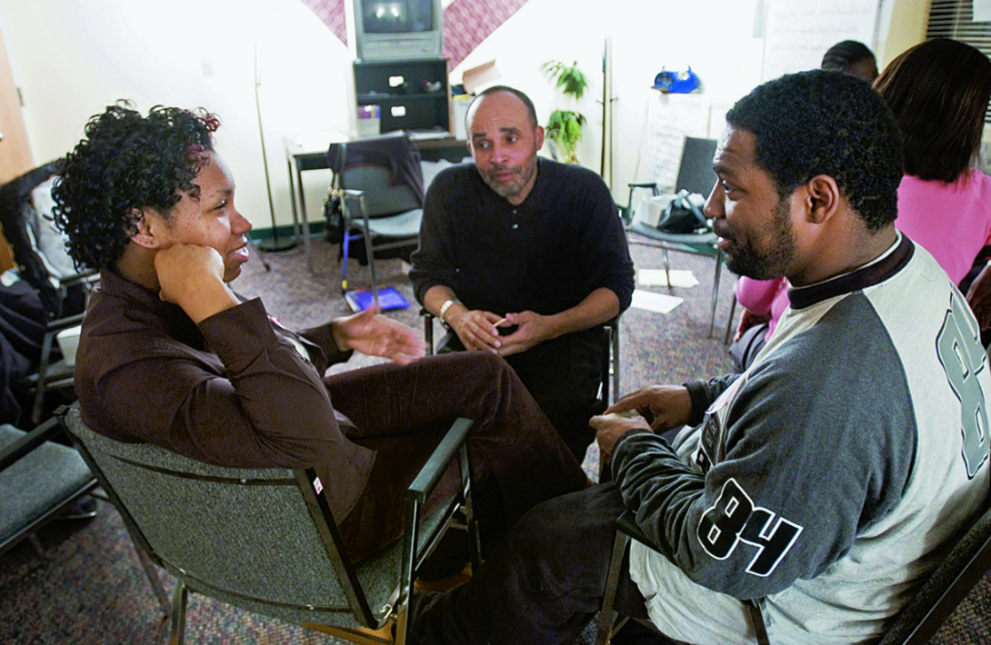
Psychology as a helping profession
Psychology as a helping profession
guide people toward healthier relationships
help people overcome anxiety and depression
help people cope with difficulties

Slide 7
How do counseling and clinical psychologists differ?
How do counseling and clinical psychologists differ?
Counseling Psychologists
help people cope with adjustments and crises
challenges related to work, school, family, and relationships
administer and interpret psychological tests
therapy and counseling
may conduct research
Clinical Psychologists
asses and treat mental, emotional, and behavioral disorders
administer and interpret psychological tests
therapy and counseling
may conduct research

Slide 8
How is a clinical psychologist different from a psychiatrist?
How is a
clinical psychologist different
from a psychiatrist?
What is a clinical psychologist?
What is a psychiatrist?
holds a PhD or PsyD
provides psychotherapy to individuals with psychological disorders
holds a MD
may prescribe drugs to treat the physiological causes of psychological disorders
may also provide psychotherapy

Slide 9
1. What Would You Answer?
1. What Would You Answer?
Psychiatrists differ from clinical psychologists in that they
help people cope with challenges and crises.
conduct research.
explore how we view and affect one another.
experiment with how people perceive, think and solve problems.
are medical doctors licensed to prescribe medication.

Slide 10
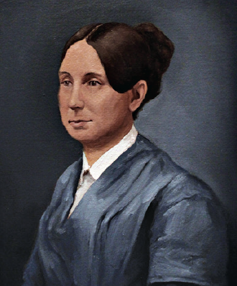
Psychology as a reforming profession
reformer who advocated for the humane treatment of the mentally ill
“I … call your attention to the state of Insane Persons confined within this Commonwealth, in cages.”
  ~Dorothea Dix
Dorothea Dix
(1802-1887)

Slide 11
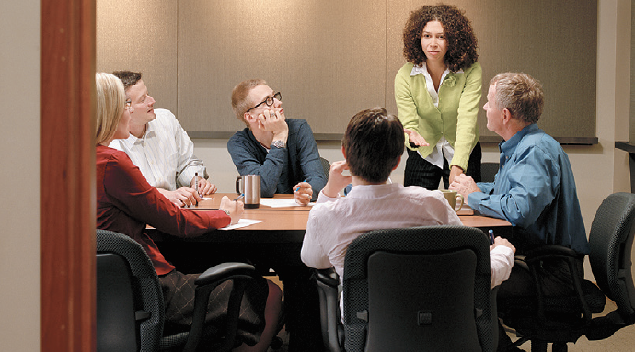
What do cognitive psychologists do, and where do they work?
What do cognitive psychologists do,
and where do they work?
They study human thinking and might work as a professor or a corporate consultant.

Slide 12
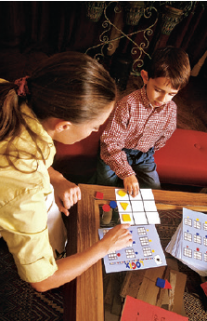
What do developmental psychologists do, and where do they work?
What do developmental psychologists
do, and where do they work?
They study how our behavior changes as we age.
They might work in a school, or day care center. They may specialize in elder behavior and work in a senior center.

Slide 13

What do educational psychologists do, and where do they work?
What do educational psychologists
do, and where do they work?
They study how we learn in different environments and in different ways.
They might work in schools or universities designing tests or teacher training.

Slide 14
What do experimental psychologists do, and where do they work?
What do experimental psychologists
do, and where do they work?
They conduct experiments to understand our behaviors and mental processes.
They might work as professors at a university or be employed at a research institution, zoo, business, or government agency.

Slide 15
What do psychometric psychologists do, and where do they work?
What do psychometric psychologists
do, and where do they work?
They use math and statistics to create, administer, score and interpret tests… intelligence or personality tests for example.
They might work in a university, a private research firm or a government agency.

Slide 16
What do social psychologists do, and where do they work?
What do social psychologists
do, and where do they work?
They study how we interact with others and how groups impact us individually.
They might work as university professors or in consulting positions, market research, or other applied fields such as social neuroscience.

Slide 17
2. What Would You Answer?
2. What Would You Answer?
Which of the following psychologists would be most likely to investigate biological, psychological, cognitive, and social changes over a lifetime?
educational
experimental
social
cognitive
developmental

Slide 18
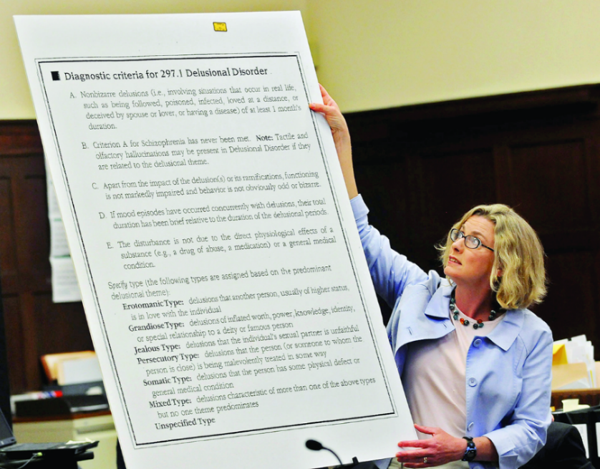
What do forensic psychologists do, and where do they work?
What do forensic psychologists
do, and where do they work?
They bring law and psychology together. They might
develop public policy for the mentally ill, consult on
jury selection or help law enforcement in criminal cases.
They might work in a law school, a court, a mental health
agency or a prison.

Slide 19
What do environmental psychologists do, and where do they work?
What do environmental psychologists
do, and where do they work?
They study how we are influenced and affected by our natural or built (urban) surroundings.
They might work as university professors or as part of an interdisciplinary team, for a consulting firm, a nonprofit, or a government agency.

Slide 20
What do health psychologists do, and where do they work?
What do health psychologists do,
and where do they work?
They work to promote health and prevent disease. They might design programs to stop smoking, lose weight, improve sleep, manage pain, and prevent psychosocial problems related to disease.
They work as university professors or in a rehabilitation center, hospital, medical school, public health agency, or private practice.

Slide 21
What do I/O psychologists do, and where do they work?
What do I/O psychologists do,
and where do they work?
They study the relationship between people and our work environments. They investigate worker productivity and personnel selection, as well as organizational structuring, consumer behavior, and training.
They work as university or in business, industry, consulting, or a government agency.

Slide 22
What do neuropsychologists do, and where do they work?
What do neuropsychologists do,
and where do they work?
They study how our brain impacts our
behavior and thoughts.
They might treat Alzheimer’s or stroke, work
with athletes and concussions or
with people with autism or ADHD.
They work as university professors and some clinical neuropsychologists may work in a hospital neurology, neurosurgery, or psychiatric unit.

Slide 23
What do rehabilitation psychologists do, and where do they work?
What do rehabilitation psychologists
do, and where do they work?
They help individuals who have lost functioning after an accident or illness.
They might work as university professors conducting basic or at a medical school, rehabilitation center, federal vocational rehabilitation agency, or in private practice working with individuals who have disabilities.

Slide 24
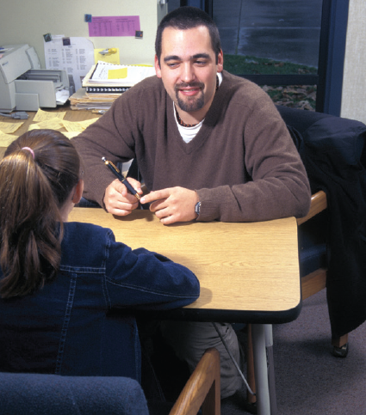
What do school psychologists do, and where do they work?
What do school psychologists do,
and where do they work?
They work with kids in school dealing with problems that may negatively impact learning in the classroom.
Most work in elementary and secondary schools.
Some might work as university professors or for a government agency or private research company.

Slide 25
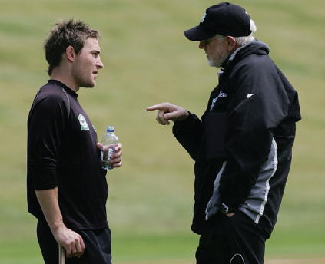
What do sports psychologists do, and where do they work?
What do sports psychologists do,
and where do they work?
They work with athletes to help them improve their performance.
They might work as university professors or as a consultant for a team, or private company. They may work with athletes that have psychological problems such as anxiety or substance abuse.

Slide 26
What do clinical psychologists do, and where do they work?
What do clinical psychologists do,
and where do they work?
They promote psychological health in individuals, groups, or organizations. May specialize in specific psychiatric disorders.
They provide therapy in private practice, mental health organizations, schools, industries, legal systems, counseling centers, correctional facilities, or the military.

Slide 27
What do community psychologists do, and where do they work?
What do community psychologists
do, and where do they work?
They work with larger groups and communities and focusing on crisis management…such as recovering from a hurricane.
They work as university professors or in federal, state, or local mental health departments or as consultants for private or government agencies.

Slide 28
What do counseling psychologists do, and where do they work?
What do counseling psychologists
do, and where do they work?
They help individuals cope with or make difficult life changes.
They work as university professors or in a counseling center, community mental health center, school, business, or in private practice.

Slide 29
3. What Would You Answer?
3. What Would You Answer?
Who among the following would most likely study the interaction of people, machines, and physical environments?
human factors psychologist
personality psychologist
industrial-organizational psychologist
counseling psychologist
educational psychologist

Slide 30
4. What Would You Answer?
4. What Would You Answer?
Anisha, a high school junior, has been struggling recently in many areas of her life. She is overweight and spends several hours per day watching Netflix and YouTube. She is having trouble keeping up in her classes and says she cannot seem to maintain her focus. She also is having trouble making friends and “fitting in” at school.
Explain how the following applied psychologists might attempt to help Anisha’s current situation.
health psychologists
school psychologists
counseling psychologists

Slide 31
Learning Target 3-1 Review
  Explain the difference between basic and applied psychology.
Scientists conduct basic research to increase the field’s knowledge base
Scientists conduct applied research to solve practical problems

Slide 32
Learning Target 3-2 Review
  Describe what psychologists working
  in various subfields do and where they work.
Psychology’s subfields include: cognitive, developmental, educational, experimental, psychometric and quantitative, social psychology,
forensic, health, industrial-organizational,
neuropsychology, rehabilitation, school, and
sport psychology and the helping professions clinical, community, and counseling

Slide 33
Learning Target 3-2 Review cont.
  Describe what psychologists working in
  various subfields do and where they work.
Work settings for psychologists include:
government agencies,
industrial and business settings,
clinics and counseling centers,
health care institutions,
schools, universities, and
research organizations.

