Slide 1
Unit 1: Psychology’s History and Approaches
UNIT 1: Scientific Foundations of Psychology
PART I: Psychology’s History and
Approaches

Slide 2

Module 2
Today’s Psychology and Its Approaches
Learning Targets
  2-1 Describe how contemporary psychology focuses on cognition, biology and experience, culture and gender, and human flourishing.
  2-2 Describe the biopsychosocial approach and psychology’s main perspectives
  2-3 Explain how psychological principles can help you learn, remember, thrive, and do better on the AP® exam.

Slide 3
How does contemporary psychology focus on cognition?
How does contemporary psychology
focus on cognition?
What is cognitive psychology?
What is cognitive neuroscience?
The study of mental processes:
thinking, perceiving, learning, remembering, communicating and solving problems.
The interdisciplinary study of the brain activity linked with cognition (including perception, thinking, memory, and language).

Slide 4
1. What Would You Answer?
1. What Would You Answer?
Which specialty in psychology is most interested in studying the link between mental activity and brain activity?
A. Humanistic psychology
B. Behavior genetics
C. Cognitive neuroscience
D. Psychodynamic psychology
E. Social-cultural psychology

Slide 5
What is psychology?
What is psychology?
Psychology is the scientific study of the
behavior and mental processes
of humans and other animals.

Slide 6
Why is psychology scientific?
Why is psychology scientific?
Psychology is scientific because it
uses empiricism and
the scientific method
to critically evaluate evidence.

Slide 7
What is behavior?
What is behavior?
Psychology examines behavior which consists of any observable and measurable action taken by a person or other animal…
….so, anything a person or animal DOES.

Slide 8
What are mental processes?
What are mental processes?
Psychology examines mental processes which consist of the internal, subjective experiences inferred from behavior…
…so sensations, perceptions, dreams, thoughts, beliefs, and feelings.

Slide 9

Psychology is Growing and Globalizing
Contemporary psychology is influenced by biology and experience, culture and gender, and human flourishing

Slide 10
How does contemporary psychology focus on cognition, biology and experience?
How does contemporary psychology
focus on cognition, biology and experience?
Nature-Nurture Issue
Is it genes or is it experience?
Contemporary psychology recognizes the
importance of both nature and nurture
as well as how they interact

Slide 11

AP® Exam Tip
What is nature?
What is nurture?
Behaviors and mental process occur because they are inborn or innate
Socrates and Plato
Rene Descartes
Charles Darwin
Behaviors and mental processes occur as a result of experience or the environment
Aristotle
John Locke’s “blank slate”

Slide 12

TRY IT.
Nature or Nurture?
  Think about YOU. Make a list of your:
  physical traits (height, hair color, etc.)
  personality traits (sense of humor, stubbornness, etc.)
  Which of the traits you listed were genetic or biologically derived? (nature)
  Which of the traits are influenced by your environment? (nurture)

Slide 13
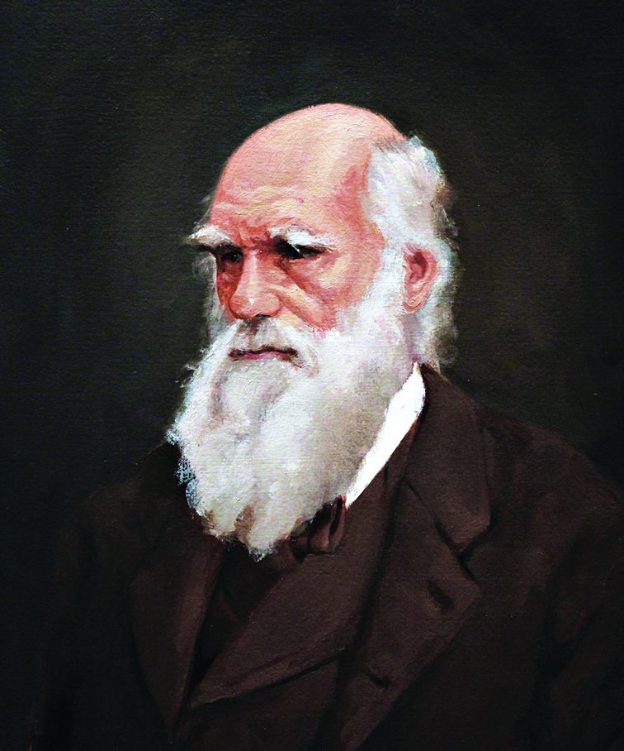
Charles Darwin and Nature v. Nurture
Argued for nature in his book On the Origin of the Species
Traits and behaviors that provide a survival or reproductive advantage are naturally selected
Charles Darwin
(1809-1882)

Slide 14
How does contemporary psychology focus on biology and experience?
How does contemporary psychology
focus on biology and experience?
Evolutionary Psychology
Behavior Genetics
The study of how behaviors and mental processes present in the species today exist because they were naturally selected
The study of the relative influence and limits of genetic (nature) and environmental (nurture) influences on behaviors and mental processes

Slide 15

Twin Studies
Twin Studies
Identical (monozygotic) twins share 100% of the same genes
Fraternal (dizygotic) twins share 50% of the same genes
Twin studies provide evidence for the relative influence of nature and nurture and are used in behavior genetics

Slide 16
What are WEIRD cultures?
What are WEIRD cultures?
Western
Industrialized
Democratic
W
I
D
Educated
Rich
E
R

Slide 17
TRY IT
Why WEIRD cultures?
Talk with your partner:
What can be learned from psychological studies done only in one place at one time?
What if the participants of a study on fashion came only from WEIRD cultures?

Slide 18
How does contemporary psychology focus on culture?
How does contemporary psychology
focus on culture?
Culture: The shared ideas, values, behaviors, and traditions, shared by a group of people and passed from one generation to the next.
Culture Impacts:
Perception of time and promptness
Ideal personal space
Beliefs about marriage and sex
Emotional display

Slide 19
How does contemporary psychology focus on gender?
How does contemporary psychology
focus on gender?
Gender: socially constructed roles and characteristics by which a culture defines male and female.
Reported gender differences
how emotions are expressed or detected
what we dream
risk for certain psychological disorders
Biological similarities
age of first steps
how we remember and forget
overall intelligence and well-being

Slide 20
How does contemporary psychology focus on biology and experience? Cont.
How does contemporary psychology
focus on biology and experience? Cont.
Shared Biological Processes Guide Behavior Across Cultures
Individuals with specific learning disorder (formerly dyslexia) show the same brain malfunction across diverse cultures.
All human languages share the same deep principles of grammar.
Nonverbal communication of basic emotions is universal (e.g. the message of a smile).

Slide 21
How does contemporary psychology focus on human flourishing?
How does contemporary psychology
focus on human flourishing?
Positive Psychology
the scientific study of human flourishing
goal of discovering and promoting human strengths and virtues
strengthening individuals and communities

Slide 22

“The main purpose of positive psychology is to measure, understand, and then build the human strengths and virtues.” ~Martin Seligman

Slide 23
2. What Would You Answer?
2. What Would You Answer?
Positive psychology, which studies the ideas behind human flourishing, is connected to which psychologist?
John Locke
Martin Seligman
Charles Darwin
Sigmund Freud
John Watson

Slide 24
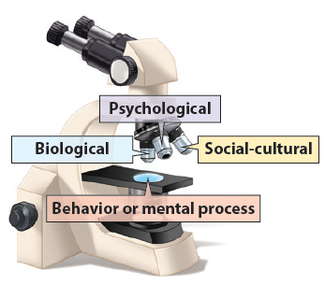
What is the biopsychosocial approach?
What is the biopsychosocial approach?
Understanding behavior or mental processes from three key viewpoints.

Slide 25
How can you explain the recent horrific school shootings across our country?
TRY IT
What are the psychological explanations?
What are the biological explanations?
What are the social-cultural explanations?

Slide 26
What are psychology’s behavioral and biological perspectives?
What are psychology’s behavioral and biological perspectives?
Behavioral Perspective
How learned and observable behaviors impact behavior and mental processes.
Biological Perspective
How biological (genetics, neural, hormonal) and physiological processes impact behavior and mental processes.

Slide 27
What is psychology’s cognitive perspectives?
What is psychology’s cognitive perspectives?
Cognitive Perspective
How interpretations of situations and mental processes (thoughts, memories, problem-solving) impact behavior and mental processes.

Slide 28
What are psychology’s evolutionary and humanistic perspectives?
What are psychology’s evolutionary and humanistic perspectives?
Evolutionary Perspective
How the natural selection of traits has promoted the survival of genes
Humanistic Perspective
How the drive for personal growth and self-actualization impact behavior and mental processes.

Slide 29
What are psychology’s psychodynamic and social-cultural perspectives?
What are psychology’s psychodynamic and social-cultural perspectives?
Psychodynamic Perspective
How unconscious drives and conflicts
impact behavior and mental processes.
Social-Cultural Perspective
How behavior and thinking vary across situations
and cultures

Slide 30
Explain the behavior in this photo from the biological perspective
TRY IT

Slide 31
Explain the behavior in this photo from the cognitive perspective
TRY IT

Slide 32
Explain the behavior in this photo from the psychodynamic perspective
TRY IT

Slide 33
3. What Would You Answer?
3. What Would You Answer?
Which of the following perspectives would be most likely to examine the unconscious motives of a person who is overly aggressive on the basketball court?
psychodynamic
socio-cultural
behavioral
evolutionary
humanistic

Slide 34
4. What Would You Answer?
4. What Would You Answer?
Which of the following perspectives is most likely to address how the encoding, storing, and retrieval of information might alter one’s thoughts or behaviors?
evolutionary
psychodynamic
humanistic
cognitive
biological

Slide 35
How can psychological principles help on the AP® Exam?
Adequate Sleep
Exercise
Long-Term Goals with Daily Aims
Growth Mindset
Prioritize Relationships

Slide 36
Are you using the strategies that help ensure a happy, successful life?
TRY IT
How many hours a night do you sleep?
How often do you exercise?
How often do you hang out with friends?

Slide 37
How can the testing effect and active processing help on the AP® Exam?
Testing Effect
Active Processing
Enhanced memory occurs as a result of retrieving, rather than rereading material.
Test yourself
Ask someone to quiz you
Enhanced memory occurs with intentional engagement with material.
Put material in your
own words
Use a mnemonic device

Slide 38
How do I use the SQ3R method?
Survey
Scan the headings and
note the module organization.
Question
Attempt to answer the questions posed
by learning targets and headings.
Find out what you do and do not know
before you read.

Slide 39
What are the next steps in the
SQ3R method?
Read
Actively read searching for answers to questions
ask more questions
take notes
Retrieve
Test yourself – use the testing effect to your advantage.
Utilize the Check Your Understanding sections.

Slide 40
What are the final steps of the
SQ3R method?
Review
Reread your notes paying attention to the organization of the module.
Write or say what something is before rereading.
Use the Module Review to summarize the answers to the learning targets.
Complete the AP® Exam Practice Questions.
Use the Unit Review sections for Key Terms, Key Contributors, AP® Exam Practice Questions, and Free-Response Questions.

Slide 41

How can psychology help on the AP® Exam?
Use spaced practice and distribute your studying over several different study sessions.
This leads to better long-lasting retention than cramming or massed practice.
Study Schedule
Monday 1 hour
Tuesday 1 hour
Wednesday 1 hour
Thursday 1 hour
Friday: The TEST

Slide 42
How else can psychology help on the AP® Exam?
Use interleaving and break up your time studying psychology with the study of other subjects.
This leads to greater
long-term retention and protection against overconfidence.
Study Schedule
Monday psych
Tuesday bio
Wednesday psych
Thursday gov
Friday: The TEST

Slide 43
What psychological techniques will help on the AP® Exam?
Think critically as you study and question assumptions and potential biases.
Process information actively as you take part in class. Listen for and write down main ideas
Relate new information to existing knowledge
Explain what you learned in class to someone else
Overlearn as you study and continue to practice and review even after you are able to remember it easily.

Slide 44
How can David Myers help on the AP® Exam?
To learn more
about the testing effect and the SQ3R
method, view the 5-minute animation,
“Make Things Memorable”,
by clicking on the link below.
Make Learning Memorable!

Slide 45
Discuss the psychological principles you use to learn and remember.
TRY IT
Distributing your study time.
Processing class information actively
Thinking critically.

Slide 46
5. What Would You Answer?
5. What Would You Answer?
Six months ago, Carlos emigrated from Mexico to the United States. Although fluent in English and an honor student in Mexico, Carlos has had difficulty completing his assignments since moving to the United States. His parents do not understand why he is not succeeding like he did in his last school. Carlos has quit participating in family traditions.
Explain how each of the following psychological perspectives might explain Carlos’ behavior:
Psychodynamic
Cognitive
Social-cultural

Slide 47
Learning Target 2-1 Review
  Describe how contemporary
  psychology focuses on cognition,
  biology and experience, culture and gender, and human flourishing.
The nature-nurture issue helps explain behavior
Darwin’s natural selection led to evolutionary and biological perspectives on behavior
Attitudes and behaviors may vary by gender or culture, but we are more similar than different
Positive psychology promotes human flourishing

Slide 48
Learning Target 2-2 Review
  Describe the biopsychosocial approach and psychology’s main perspectives
The biopsychosocial approach integrates the biological, psychological and social-cultural viewpoints
Psychology’s main perspectives are: behavioral, biological, cognitive, evolutionary, humanistic, psychodynamic, and social-cultural.

Slide 49
Learning Target 2-3 Review
  Explain how psychological principles
  can help you learn, remember,
  thrive, and do better on the AP® exam.
The testing effect shows we remember more when practicing retrieval
The SQ3R method can help you learn and remember
Four study tips: distribute your study time, learn to think critically, process class information actively, and overlearn.
Flourish: sleep, exercise, grow, form relationships

